Slide 1

MOVIES AND TV SHOWS EXCEL PROJECT

Slide 2

Welcome to the NETFLIX Dashboard Project—an immersive exploration into the world of NETFLIX through the lens of data analysis. In this presentation, we unveil the insights gleaned from an in-depth analysis of NETFLIX movies and TV shows, meticulously curated and visualized using the power of Microsoft Excel. Through interactive visualizations and intuitive user interfaces, our dashboard project transforms raw data into actionable insights, bridging the gap between information and understanding. So, without further ado, let's dive into the world of NETFLIX and unlock the secrets hidden within its digital vaults. Welcome to the NETFLIX Dashboard Project—where data tells the story of entertainment.

Slide 3
The data has been collected from Kaggle: Link to Kaggle dataset
This tabular dataset consists of listings of all the movies and tv shows available on Netflix, along with details such as - cast, directors, ratings, release year, duration, etc.
I have tried finding the below insights from the dataset available:
1. Find information about a particular show_ID
2. Percentage of type of show
3. Total number of releases of movies and TV shows per year from 1980 4. Top 10 Rating Types of movies and TV shows
5. Top 5 actors in movies and TV shows 6. Top 10 countries of movies and TV shows 7. Top 10 genres of movies and TV shows
8. Top 10 directors on Netflix
9. Movie with max and min duration
10. TV show with max number of season

Slide 4
I have used VLOOKUP and XLOOKUP in MS Excel to find the information about a particular show_ID. The same has been shown below:

Slide 5
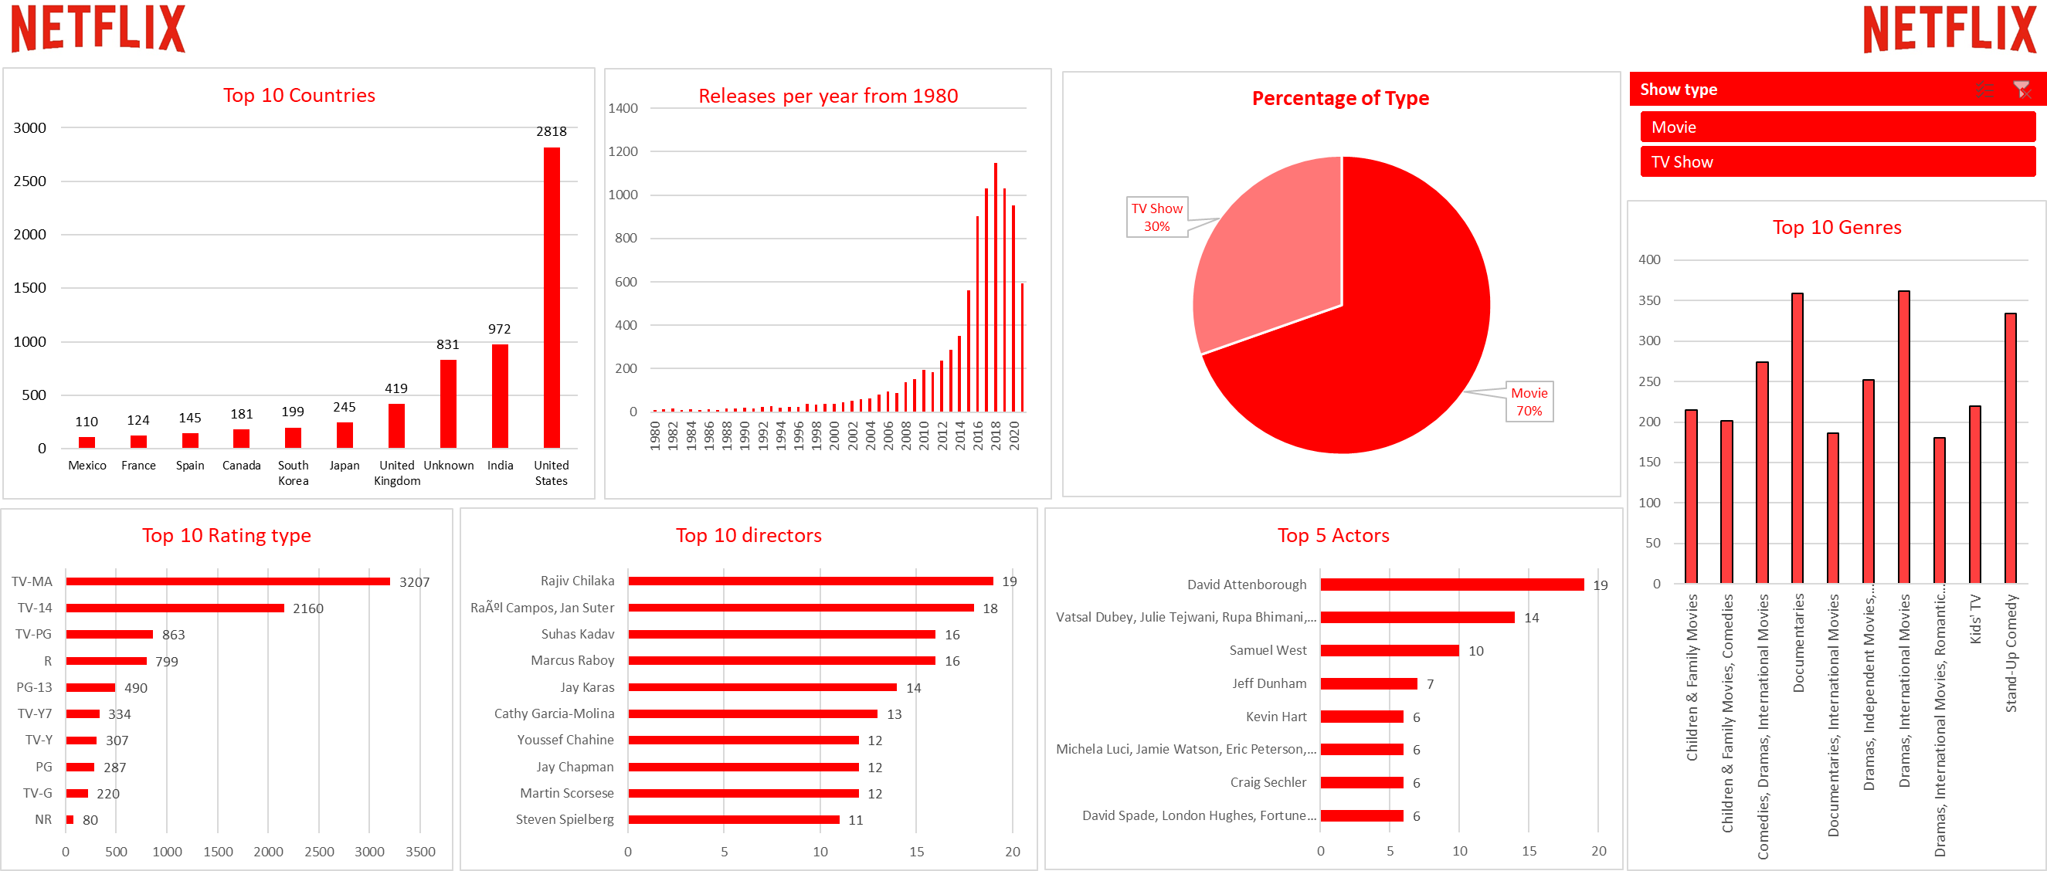
Movies and TV Shows Dashboard

Slide 6
With the use of FILTER, INDEX, and MATCH Functions: Movie with maximum duration: Black Mirror Bandersnatch
Movie with minimum duration: Louis C.K. 2017
TV show with the maximum number of seasons: Grey’s Anatomy with 17 seasons
Thank you for joining me on this insightful journey through the world of Netflix. I hope that my presentation has provided you with valuable insights and a newfound appreciation for the intersection of entertainment and data analysis. Should you have any questions, feedback, or ideas to share, please don't hesitate to reach out.

